Slide 1
INF10025
Data Management and Analytics
Week 5 – Part 1
Entity Relationship Modelling and Diagrams
SQL

Slide 2
Database Creation overview
Creating a table is easy.
Creating multiple tables is just as easy.
Deciding what data is stored in each table can be a difficult decision.
One way to assist in the design of the database tables is to use
Entity Relationship Models & Diagrams

Slide 3
Entity Relationship Model & Diagram
Entity Relationship Model
  A logical representation of data required by an organisation
  Uses entities to represent people, objects, events…
  Identifies relationships between various entities
  Based around business rules of the organisation
Entity Relationship Diagram
  A graphical representation of a the ERM
  An ER Model / ER Diagram does not actually store any data
  An ER Model is a plan.

Slide 4
ERDs vs Access Relationship Diagrams
An Entity-Relationship Diagram (ERD) use natural keys
  No surrogate key ( only real-world keys ) This will be discussed later
An Access Relationship Diagram matches the existing database tables
  If surrogate keys are used in a table,
  then these appear in the Access Relationship Diagram
An Access Relationship Diagram is not an ERD
ERD exists before a database is built
Access relationship diagram occurs after the database is built

Slide 5
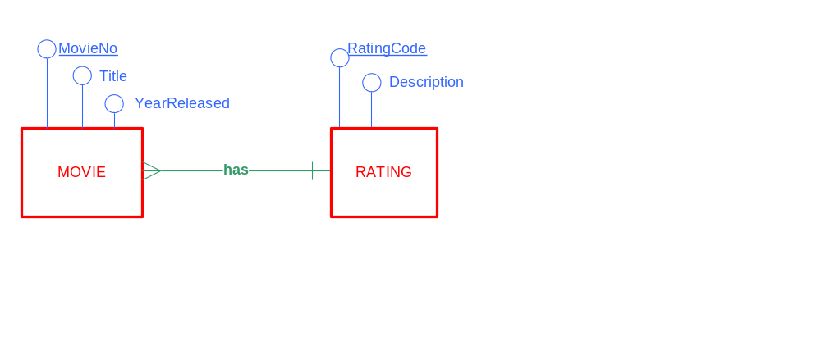
E-R Diagrams
An Entity-Relationship Diagram (ERD)
is a way to express the structure of information used by an organization or business in the form of a diagram
used to assist in database design
    391 Avatar 2009 PG Parental Guidance
    231 The Matrix 1999 M Mature Audience

Slide 6

E-R Diagrams - Entities
The E-R Diagram has three major components:
  Entities
    This diagram has two entities: Subject and Lecturer

Slide 7
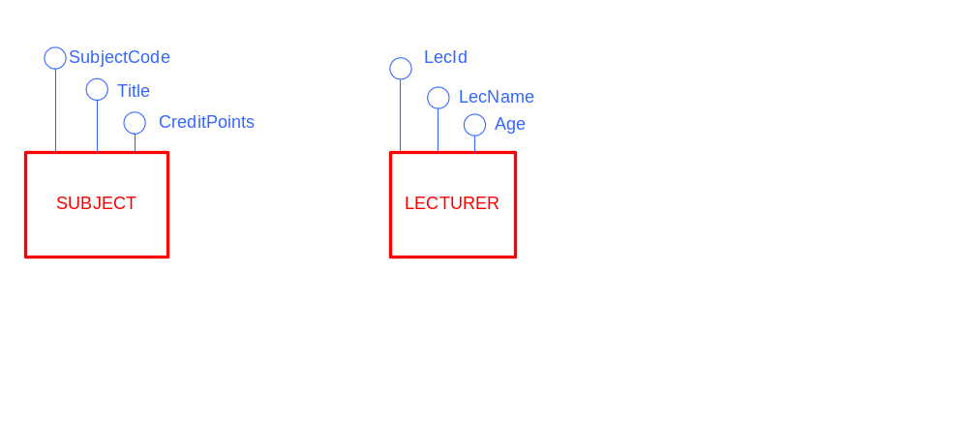
E-R Diagrams - Attributes
The E-R Diagram has three major components:
  Entities: Subject, Lecturer
  Attributes: This diagram has six attributes:
    SubjectCode, Title, CreditPoints,
    LecId, LecName, Age

Slide 8
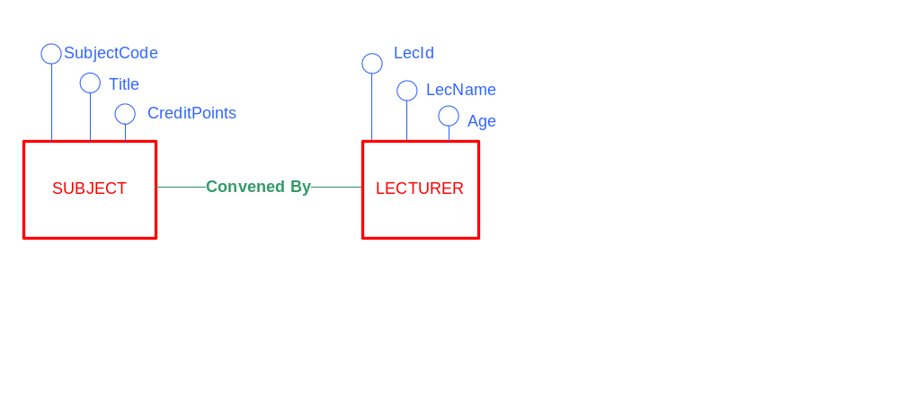
E-R Diagrams - Relationships
The E-R Diagram has three major components:
  Entities: Subject, Convenor
  Attributes: SubjectCode, Title, CreditPoints, LecID…
  Relationships: This diagram shows a that there is a relationship
  between the entities subject and lecturer

Slide 9
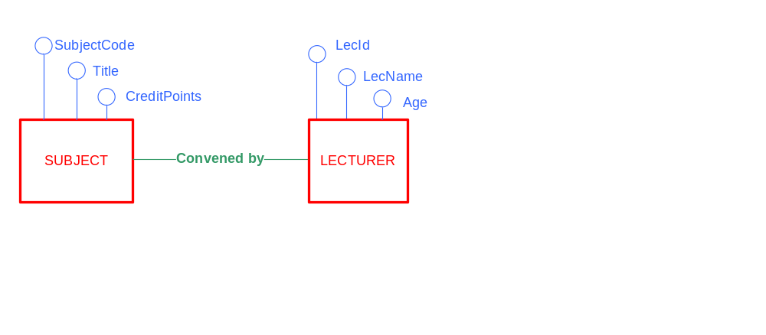
E-R Diagrams & Sample Data
When building an ER Diagram, always consider examples of data that would be stored in each entity.
  After all, that's why we build a database – to store data
  Subject Data
  INF10002 Database, Analysis & Design 12.5
  INF10003 Intro to Business Info Systems 12.5
  Lecturer Data
  207 John Smith 37
  119 Jane Pitt 26

Slide 10
E-R Diagrams & Business Rules
Consider some business rules:
    A student must only be enrolled in one course at any time
    A student may enrol in many subjects at one time
    A subject must only have one convenor
    An employee must only have one tax file number
Some business rules are common amongst many organisations
Some business rules are unique to a single organisation
Very few organisations have identical business rules
    (Thank goodness – or jobs in the IT industry are in trouble)
  Your ERD design and subsequent database design must
  meet the needs of the organisation's business rules

Slide 11
E-R Diagrams & Business Rules
What are all of the organisation's business rules about data requirements?
Where are there business rules stored?
  "Documenting rules and policies of an organization that govern data is exactly what data modeling is all about."
        Hoffer, Prescott, McFadden. Modern Database Management.
There is an entire industry based around obtaining business rules
Some computing jobs can be 'off-shored'.
Data modelling is not one of those jobs.

Slide 12
E-R Diagrams & Business Rules
Why is discovering business rules so difficult?
  No single person knows all of the business rules of an organisation
  Individuals can't tell you every rule
  Individuals won't to tell you every rule (some will tell you rules that don't exist)
    Fear, distrust, changing their job…
  Lack of existing documentation
  Rules change as business needs changes, regulations change, competition changes, technology changes.
    Changes can occur during the modelling phase
Rule gathering topic discussed in future subjects
such as RAM (Req. Analysis & Modelling)
This semester in DAD, you will be given all of the business rules

Slide 13
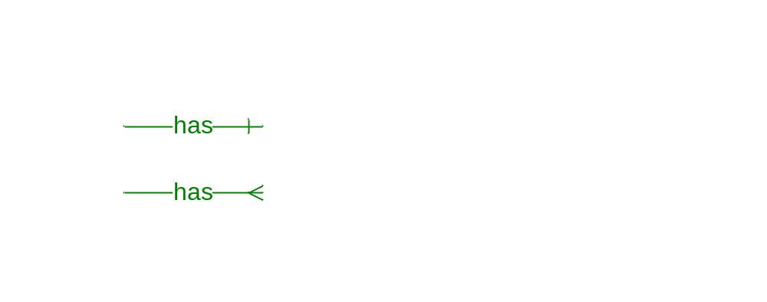
Cardinality constraints
Cardinality constraints specify how many instances of one entity
are related to instances of another entity
The answer is always One or Many
At Swinburne:
    How many lecturers convene a single subject? ONE
    How many subjects can a lecturer convene? MANY
The Cardinality is drawn onto the Relationship line
  ONE is drawn as a single line
  MANY is drawn as a crow's foot

Slide 14
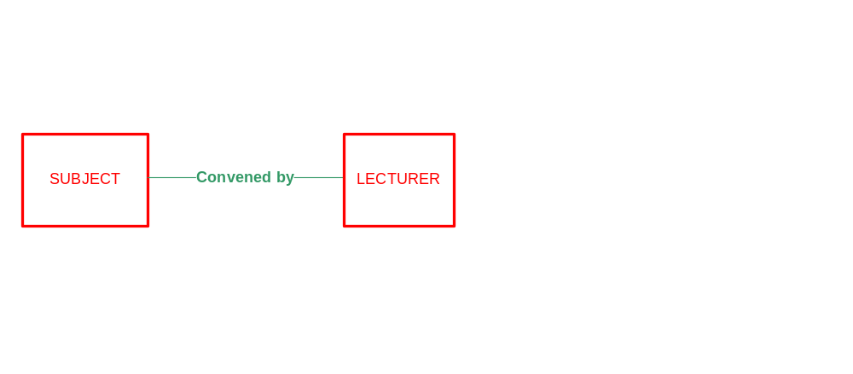
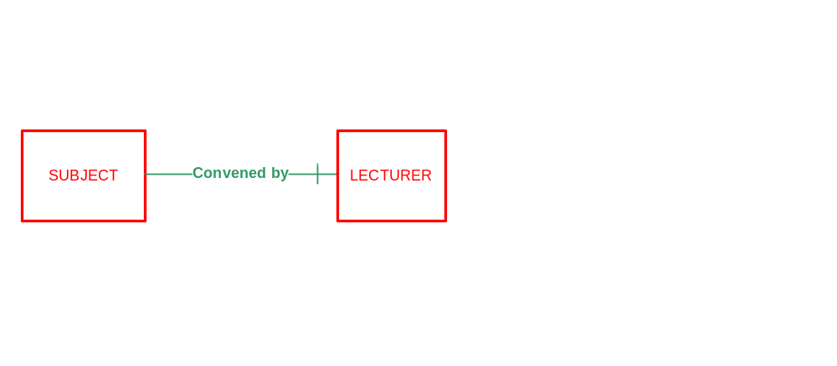
Determining Cardinality - part 1
Let's consider the "convened by" relationship
Let's consider the LEFT end of the relationship
Let's consider just ONE instance of a subject (e.g. INF10002)
How many lecturers convene this one subject? ONE
  Draw the cardinality symbol at the RIGHT end of the relationship
Now read this diagram left to right
  Start the sentence by using one instance of the subject entity
"One Subject is convened by ONE lecturer"

Slide 15
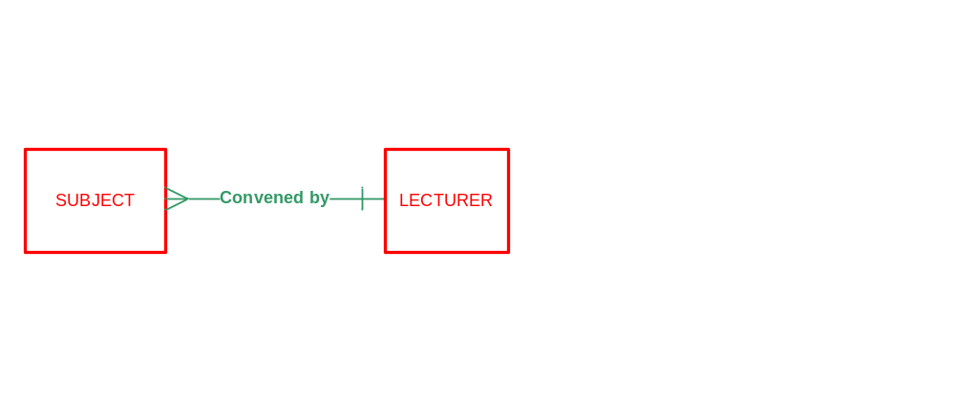
Determining Cardinality - part 2
Let's again consider the "convened by" relationship
Let's consider the RIGHT end of the relationship
Let's consider ONE instance of a lecturer (e.g. Fred Smith)
How many subjects are convened by this one lecturer? MANY
Draw the cardinality symbol at the LEFT end of the relationship
Now read this diagram right to left
  Start the sentence by using one instance of the lecturer entity
"One Lecturer convenes MANY Subjects"

Slide 16

Summary - Cardinality Constraints
What does this diagram say?
  ONE Subject is convened by ONE Lecturer
  ONE Lecturer convenes MANY Subjects
Always begin each sentence with the word ONE (never begin with "many")
The only difficulty with this diagram is that the relationship name "Convened by" only reads left to right.
The reader must rephrase those words so that it makes sense when
reading right to left

Slide 17
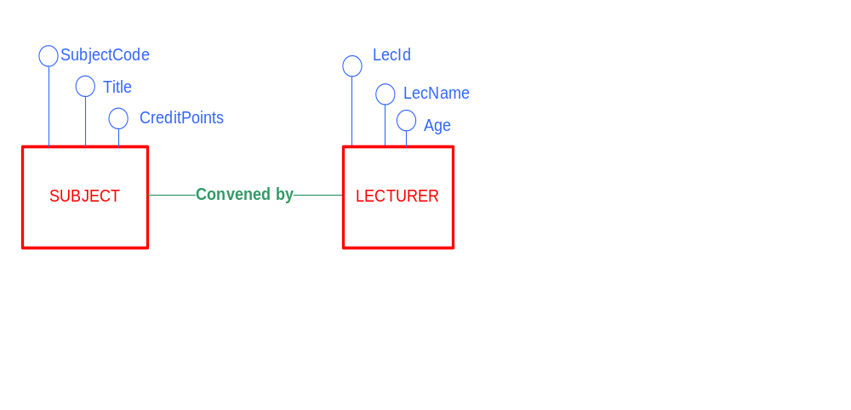
Entities Instances
  An entity instance is one set of values for the attributes of an Entity
  E.g. This is an instance of the Lecturer Entity
  LecId 207
  LecName John Smith
  Age 37
  E.g. This is another instance of the Lecturer Entity
  LecId 119
  LecName Jane Pitt
  Age 26

Slide 18
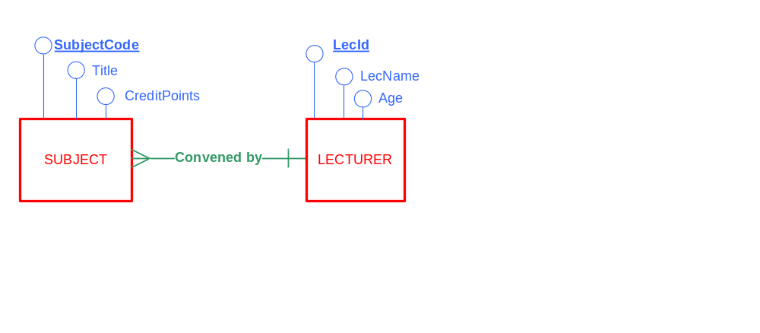
E-R Diagrams – Identifiers
An identifier is an attribute(s) that uniquely identifies an entity instance
Same concept as a Primary Key
  Rules
      Every entity must have an identifier
      Every instance of an entity must have a unique identifier
      No duplicates
      The value of an identifier cannot be empty / null
  Entity identifiers are
  underlined on the ERD

